Slide 1
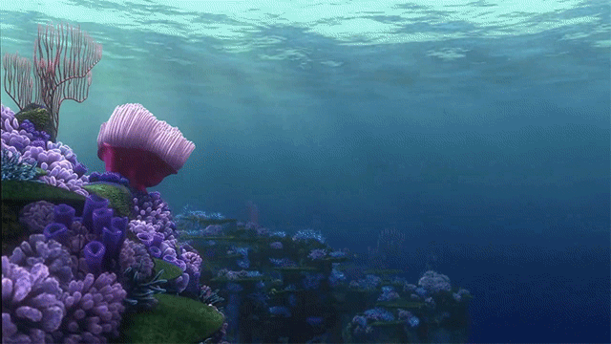
Assessing Coral Resilience
Impacts of Sedimentation and Temperature
on Coral Survival
Alaina Holland & Haleigh Schwartz
February 7, 2024
Notes:
Looks awesome!!!

Slide 2
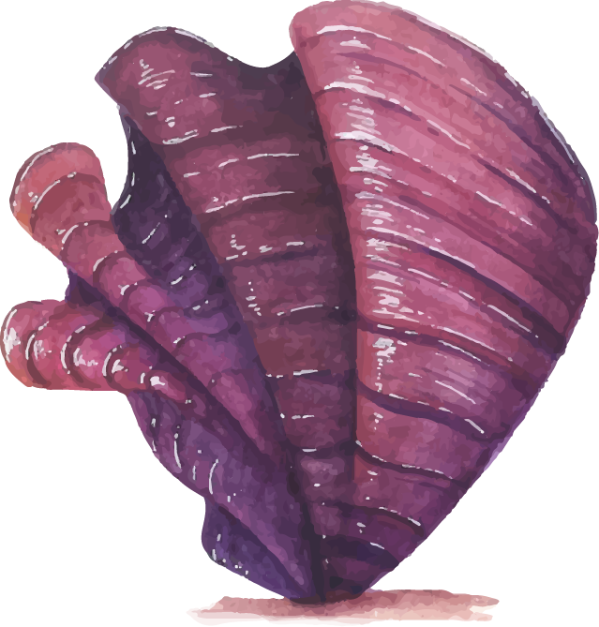

Table of Contents
BACKGROUND
DATA AND METHODOLOGY
RESULTS/ANALYSIS
CONCLUSION/NEXT STEPS

Slide 3
BACKGROUND

Slide 4
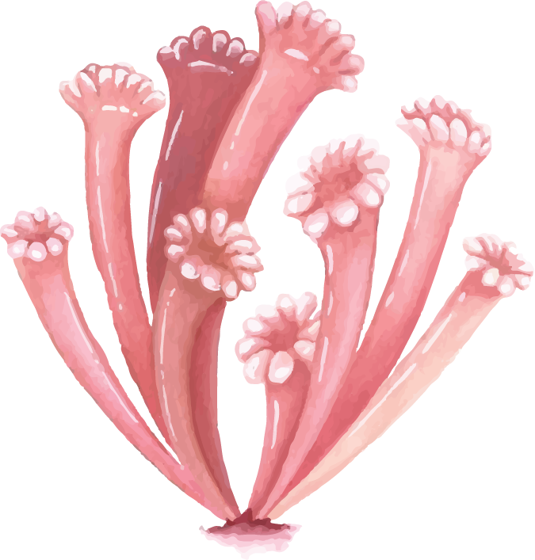
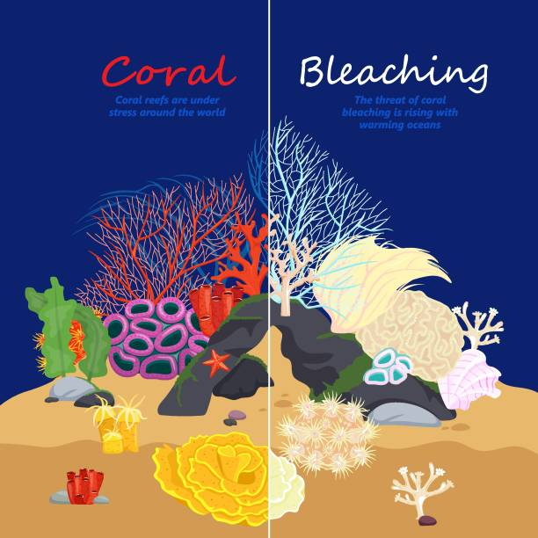
Background³
Coral is essential to the ocean’s ecosystem and the economy of coastal towns.
Corals are dying out due to increasing global temperatures and harmful human activities (anthropogenic effects).
Coral has enough energy to battle one threat, but two leads to population decline.
Dredging and bleaching are two threats coral is currently battling.
1
Notes:
Script: corals provide food and shelter for thousands of oceanic species. They physically support the shoreline and help equilibrate the atmospheric Co2 and Ca. They also benefit coastal towns by providing a source of seafood, medicinal products, and tourist income.

Slide 5

More Background & Study Goal³
Humans are the cause of both increased atmospheric CO₂ (indirect cause of global warming) and anthropogenic sediment damaging corals.
Dredging leads to highly turbid water conditions and the creation of fine sediment that blocks sunlight, suffocates coral, encourages bacterial growth and introduces toxins to coral.
Study question: Will reducing anthropogenic sedimentation allow corals to endure climate change?
2
Notes:
Goal of the Study:
Assess the impact of sedimentation types and concentrations on coral resilience.
Provide insights for reef managers and policymakers.

Slide 6
DATA AND METHODOLOGY

Slide 7
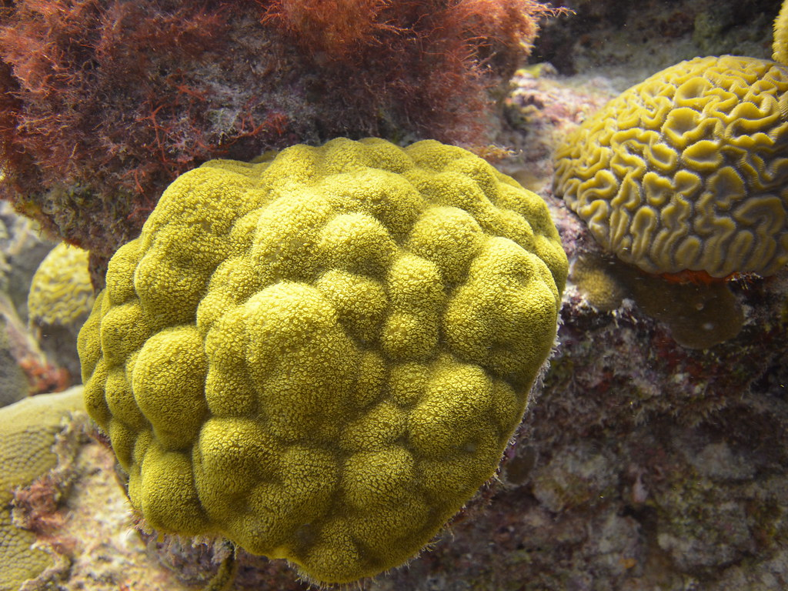
Data and Methodology⁴
Study Type: Experimental Study
Experiment Units: Coral recruits of Porites astreoides
Sample Size:
First Experiment (natural sediment): 1,503 newly settled coral recruits
Second Experiment (anthropogenic sediment): 80 five-month-old coral recruits
Natural sediment: Fine, granular sediment naturally occurring in the ocean.
Anthropogenic sediment: Man-made sediment from dredging, typically larger than natural sediment.
Mustard Hill Coral (Porites astreoides)
Notes:
Experimental design with coral recruits, varying temperature (26°C and 30°C), and sediment concentrations (30-120 mg/cm²).
Porites astreoides, commonly known as mustard hill coral or yellow porites, is a colonial species of stony coral in the family Poritidae
Two experiments using natural reef sediment and anthropogenic sediment.
Sample sizes: 1,503 and 80 coral recruits.
Controlled conditions in tanks; regular monitoring over 1-3 months.

Slide 8
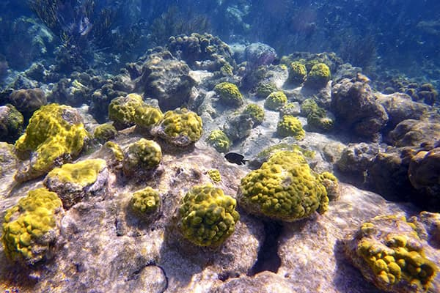
Data and Methodology⁴
Primary Response Variable: Survival of coral recruits (in Weeks)
Factors:
Temperature:
Two levels: 26°C (ambient) and 30°C (elevated)
Sedimentation:
Four levels: 30, 60, 90, 120 mg cm²
Censoring: Interval (failure happened sometime within a week’s timespan)
Note:
Sedimentation level not used in analysis
Random Sampling was used in the log rank step analysis
Mustard Hill Coral (Porites astreoides)
Notes:
Experimental design with coral recruits, varying temperature (26°C and 30°C), and sediment concentrations (30-120 mg/cm²).
Porites astreoides, commonly known as mustard hill coral or yellow porites, is a colonial species of stony coral in the family Poritidae
Two experiments using natural reef sediment and anthropogenic sediment.
Sample sizes: 1,503 and 80 coral recruits.
Controlled conditions in tanks; regular monitoring over 1-3 months.

Slide 9
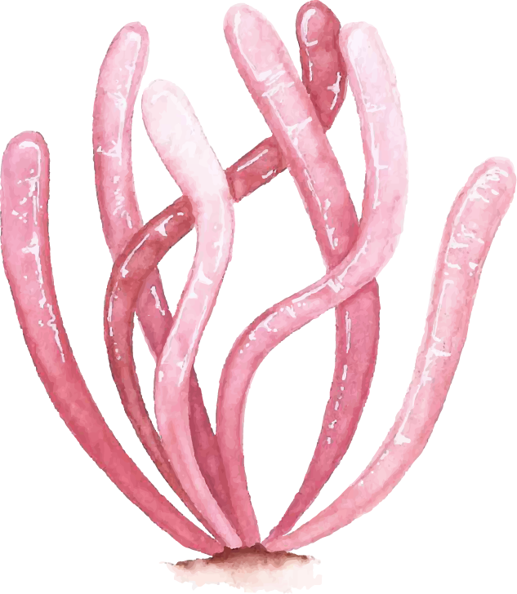
Data and Methodology³
Data Collection:
Collected planulae from adult colonies off of the Florida Keys
Allowed planulae to settle on pre-conditioned settlement tiles in vitro
Applied different temperature and sedimentation levels
Monitored coral recruit survival weekly over 1-3 months
Logistics and Challenges:
Maintained tanks with controlled conditions (temperature, light, sedimentation)
Acknowledged variations in planulae quality over time
Possible substrate-related biases using settlement tiles
2nd experiment occurred after the 1st experiment (Differing experiment time period)
Notes:
Experimental design with coral recruits, varying temperature (26°C and 30°C), and sediment concentrations (30-120 mg/cm²).
Two experiments using natural reef sediment and anthropogenic sediment.
Sample sizes: 1,503 and 80 coral recruits.
Controlled conditions in tanks; regular monitoring over 1-3 months.

Slide 10
RESULTS/ANALYSIS

Slide 11
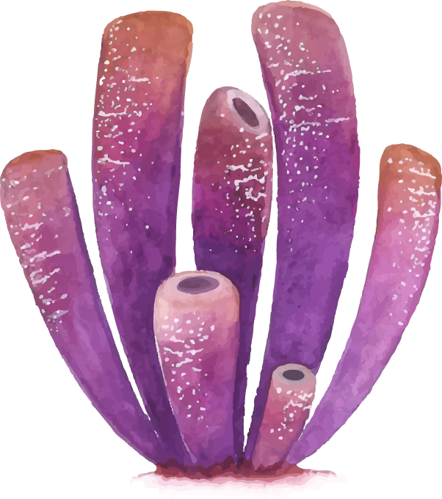
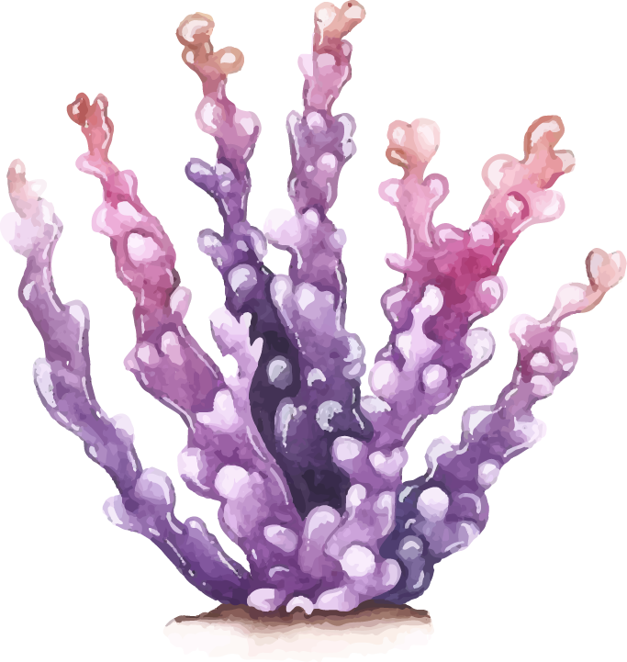
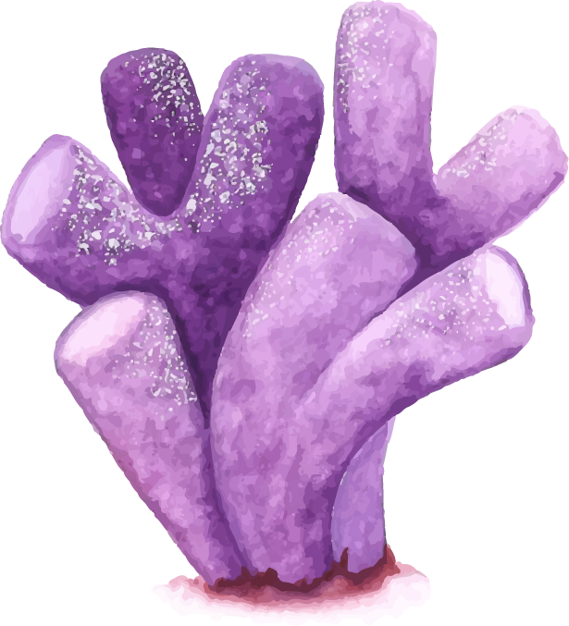
Results/Analysis: Summary Statistics
Time in Weeks
Sediment Type | Temperature (°C) | Avg Survival | Shortest Survival | Q1 | Median Survival | Q3 | Longest Survival
Anthropogenic | 26 | 3.30 | 1 | 2 | 4 | 5 | 5
Anthropogenic | 30 | 1.95 | 1 | 1 | 2 | 2 | 4
Natural | 26 | 5.26 | 1 | 2 | 4 | 8 | 12
Natural | 30 | 3.06 | 1 | 1 | 3 | 4 | 12
Notes:
Minimum Survival Time: 1 week,
Median for Anthropogenice was 2-4 weeks
Median for NAtural was 3-4 Weeks
Temperature Impact:
Higher temperatures lead to lower coral survival rates.
Corals exposed to 30°F temperatures have significantly shorter survival times compared to those at 26°F.
Sediment Influence:
Natural sediment tends to support higher coral survival rates compared to anthropogenic sediment.
Regardless of temperature, corals in natural sediment show better survival outcomes.

Slide 12
Results/Analysis: Summary Statistics
Time in Weeks
Sediment Type | Temperature (°C) | Avg Survival | Shortest Survival | Q1 | Median Survival | Q3 | Longest Survival
Anthropogenic | 26 | 3.30 | 1 | 2 | 4 | 5 | 5
Anthropogenic | 30 | 1.95 | 1 | 1 | 2 | 2 | 4
Natural | 26 | 5.26 | 1 | 2 | 4 | 8 | 12
Natural | 30 | 3.06 | 1 | 1 | 3 | 4 | 12
Notes:
Minimum Survival Time: 1 week,
Median for Anthropogenice was 2-4 weeks
Median for NAtural was 3-4 Weeks
Temperature Impact:
Higher temperatures lead to lower coral survival rates.
Corals exposed to 30°F temperatures have significantly shorter survival times compared to those at 26°F.
Sediment Influence:
Natural sediment tends to support higher coral survival rates compared to anthropogenic sediment.
Regardless of temperature, corals in natural sediment show better survival outcomes.

Slide 13
Results/Analysis: Summary Statistics
Time in Weeks
Sediment Type | Temperature (°C) | Avg Survival | Shortest Survival | Q1 | Median Survival | Q3 | Longest Survival
Anthropogenic | 26 | 3.30 | 1 | 2 | 4 | 5 | 5
Anthropogenic | 30 | 1.95 | 1 | 1 | 2 | 2 | 4
Natural | 26 | 5.26 | 1 | 2 | 4 | 8 | 12
Natural | 30 | 3.06 | 1 | 1 | 3 | 4 | 12
Notes:
Minimum Survival Time: 1 week,
Median for Anthropogenice was 2-4 weeks
Median for NAtural was 3-4 Weeks
Temperature Impact:
Higher temperatures lead to lower coral survival rates.
Corals exposed to 30°F temperatures have significantly shorter survival times compared to those at 26°F.
Sediment Influence:
Natural sediment tends to support higher coral survival rates compared to anthropogenic sediment.
Regardless of temperature, corals in natural sediment show better survival outcomes.

Slide 14
Results/Analysis: Summary Statistics
Time in Weeks
Sediment Type | Temperature (°C) | Avg Survival | Shortest Survival | Q1 | Median Survival | Q3 | Longest Survival
Anthropogenic | 26 | 3.30 | 1 | 2 | 4 | 5 | 5
Anthropogenic | 30 | 1.95 | 1 | 1 | 2 | 2 | 4
Natural | 26 | 5.26 | 1 | 2 | 4 | 8 | 12
Natural | 30 | 3.06 | 1 | 1 | 3 | 4 | 12
Notes:
Minimum Survival Time: 1 week,
Median for Anthropogenice was 2-4 weeks
Median for NAtural was 3-4 Weeks
Temperature Impact:
Higher temperatures lead to lower coral survival rates.
Corals exposed to 30°F temperatures have significantly shorter survival times compared to those at 26°F.
Sediment Influence:
Natural sediment tends to support higher coral survival rates compared to anthropogenic sediment.
Regardless of temperature, corals in natural sediment show better survival outcomes.

Slide 15
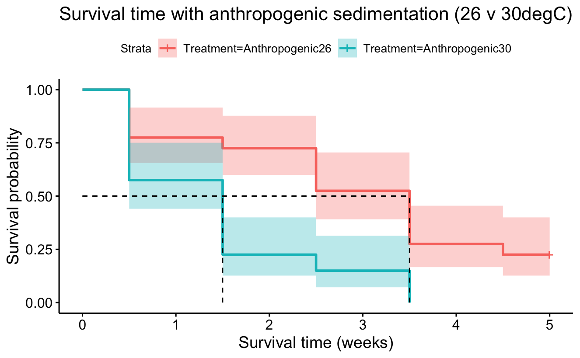
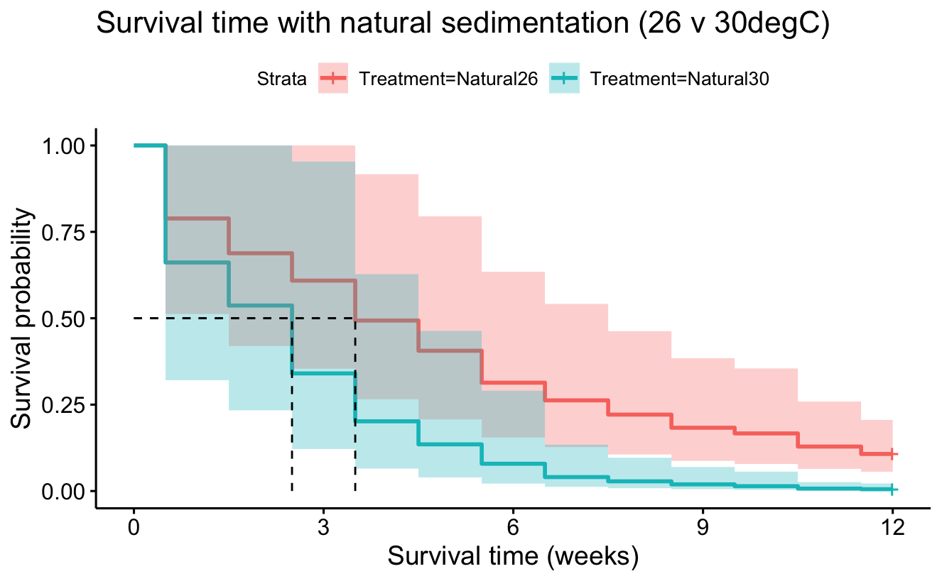
Increased temperature decreases survival time
***
***
*** (p-value = 8e-06)
*** (p-value = <2e-16)
Note: *** p value between temps (not distinguishing sedimentation types) = 7e-08 (used random sampling)

Slide 16
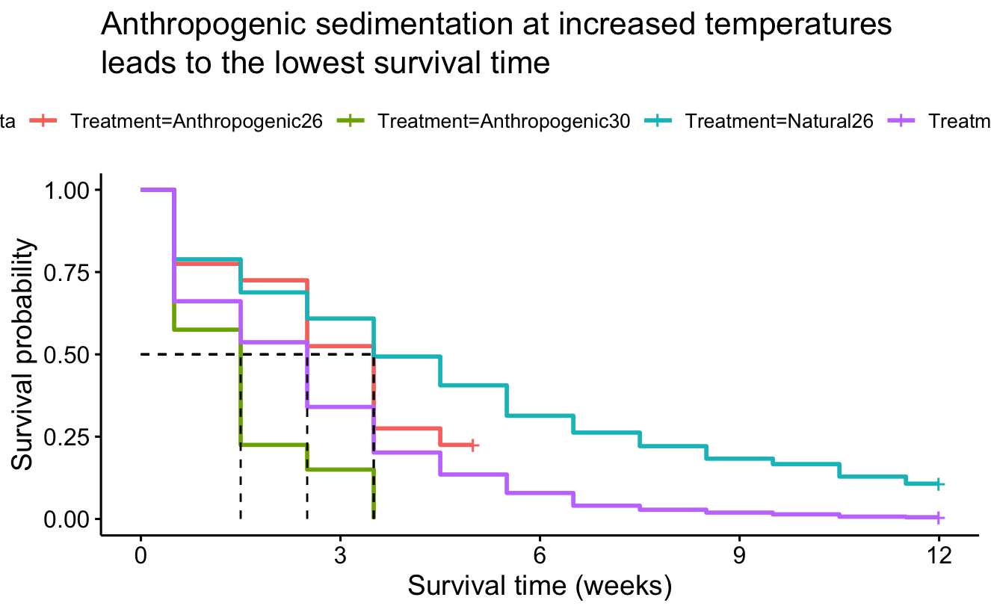

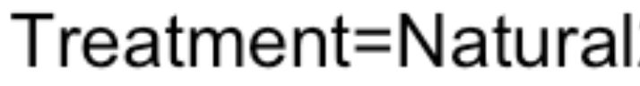
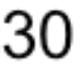
***
*** (p-value = 9e-07, used random sampling)
Note: * p value between sediment types (not distinguishing temperatures) = 0.04 (used random sampling)
Notes:
Takeaway: both anthropogenic sediment and increased temperatures separately decrease survival probability of coral. Increasing temperatures has a worse effect on survival rates than anthropogenic sediment, but just having one threat (sediment type or temperature) fares better for coral than when they use energy to combat two. While increased temperatures may be inevitable, we can help coral successfully face that threat by avoiding dredging where coral is located or only dredging at times when water temperatures are at their lowest.

Slide 17
Conclusion/
Next Steps

Slide 18
Conclusion
Both anthropogenic sediment and high temperatures negatively impact coral survival.
High temperatures have a greater detrimental effect compared to sediment.

Slide 19
Limitations/Next Steps
Limitations:
The experiments had different time spans.
Sediment levels were not included in the provided dataset.
It's unclear if coral in anthropogenic sediment could survive beyond 5 weeks.
Next Steps
Repeat experiments with consistent time frames and varying sediment levels.
Explore coral survival in anthropogenic sediment over longer durations than 5 weeks.

Slide 20
Recommendation
Limit anthropogenic creating activities (Dredging) to colder parts of the year, when temperatures are around 26 degrees Celsius, to mitigate adverse effects on coral survival.

Slide 21
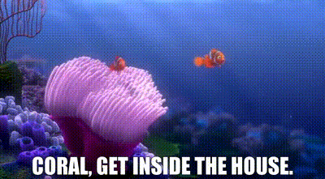

Slide 22
Resources
Bergbauer, A. (2021). Coral bleaching image stock illustration [Infographic]. iStock by Getty Images. https://www.istockphoto.com/vector/coral-bleaching-image- gm1302280379-394069726
Ekaterinabaikal. (n.d.). Dredging machine. [Cartoon image]. 123rf. https://www. 123rf.com/photo_83027093_huge-crane-barge-industrial-ship-that-digs-sand-marine-dredging-digging-sea-bottom-light-sea-green.html
Fourney, F., & Figueiredo, J. (2018). Additive negative effects of anthropogenic sedimentation and warming on the survival of coral recruits Scientific Reports, 7.(12380), 1-8. https://doi.org/10.1038/s41598-017-12607-w
Fourney, F., & Figueiredo, J. (2018). Data from: Additive negative effects of anthropogenic sedimentation and warming on the survival of coral recruits [Dataset]. Dryad. https://doi.org/10.5061/dryad.4t85s

